Slide 1

Session 3: Leveraging Infrastructure as Code for Your Hybrid SQL Server Estate
Introductory session on using Infrastructure as Code practices

Slide 2
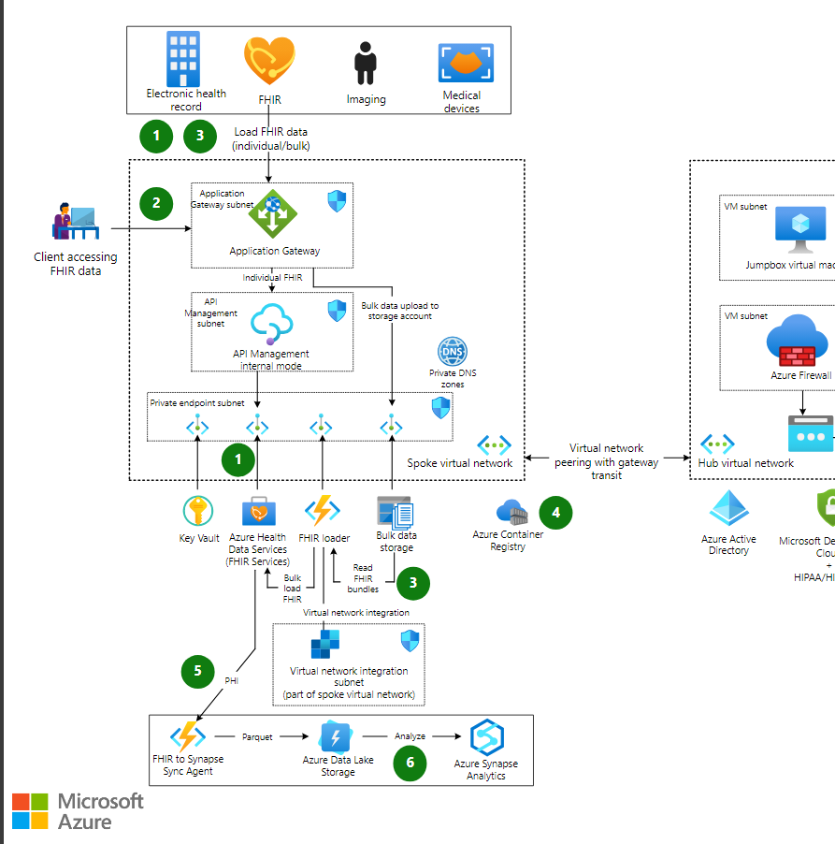
What is Infrastructure as Code (IaC)?
Infrastructure as Code (IaC) refers to the process of managing and provisioning infrastructure through code and configuration files rather than through manual processes. IaC allows infrastructure to be treated like software - where servers, networks and other resources can be spun up and managed automatically through code.

Slide 3

Why IaC for Microsoft Data Platform?
Consistency
Efficiency
Ensures consistent and standardized deployments across environments.
automates tasks and accelerates deployments.
Reliability
Security
reduces configuration drift and human errors.
Control of available options and defaults

Slide 4
Key Concepts of IaC
Idempotency
Ensures infrastructure can be provisioned repeatedly with the same outcome.
Declarative syntax
Allows engineers to specify the desired end-state configuration rather than steps to reach it.
Immutability
Infrastructure components are replaced instead of changed in-place to reduce drift.

Slide 5
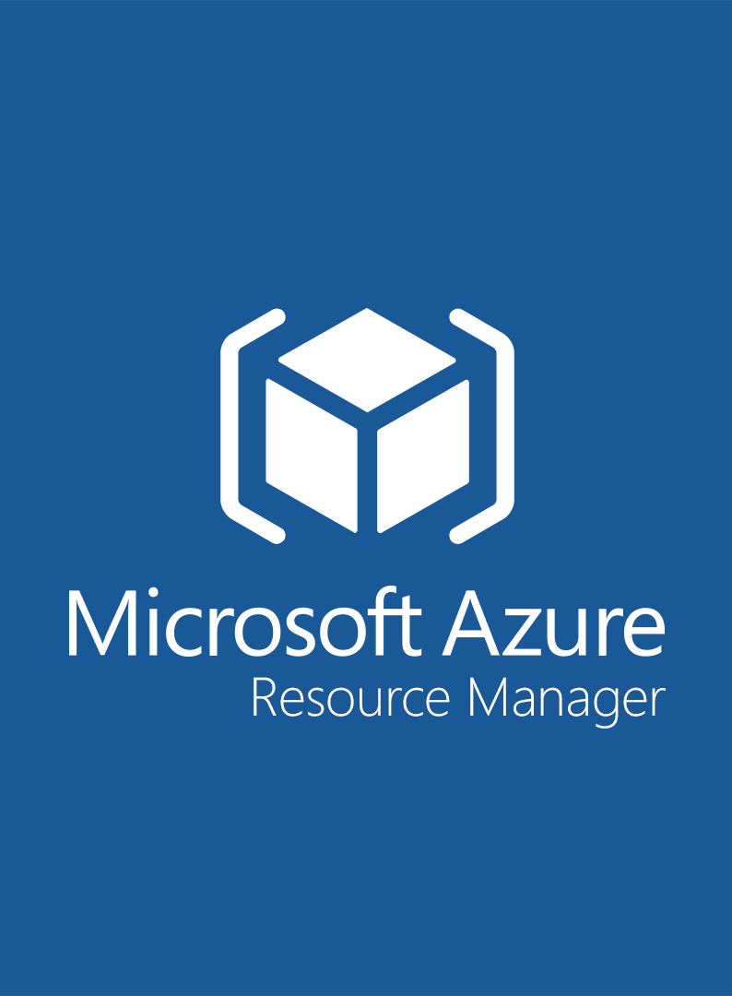

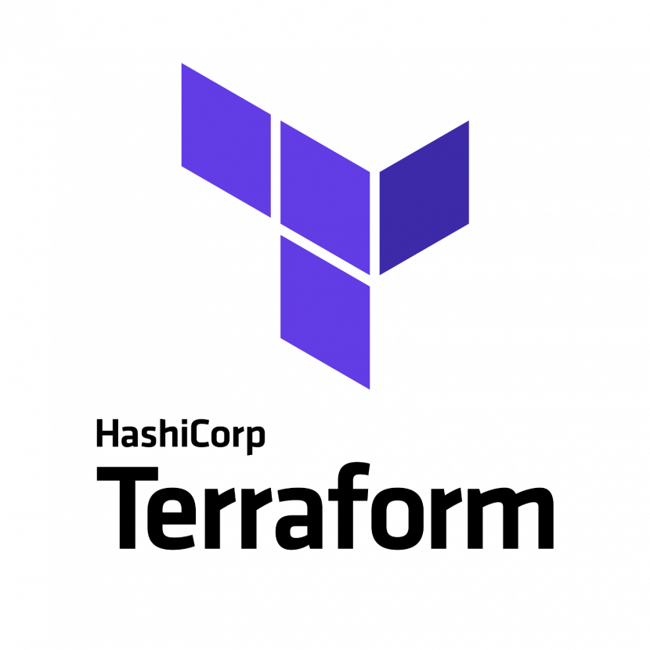
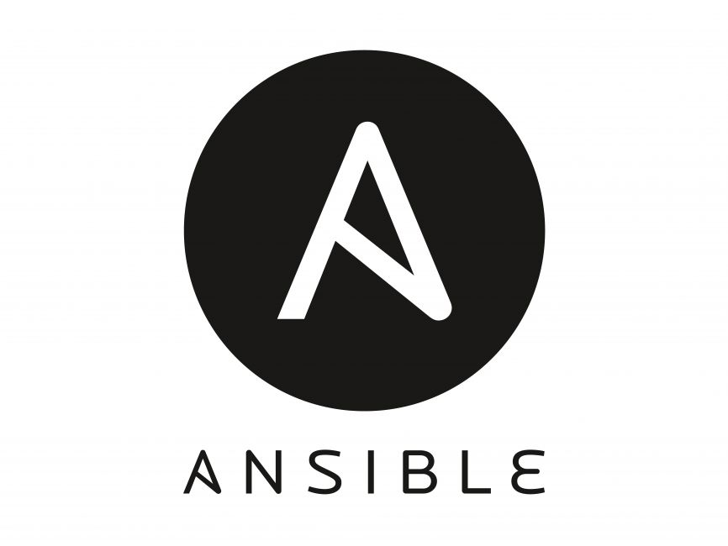

Tools for Implementing IaC
Terraform
Azure Resource Manager
Bicep
Ansible
Puppet
Terraform is a popular open source IaC tool developed by HashiCorp that uses a declarative syntax to define, provision and manage infrastructure.
Bicep bicep bicep bicep
Ansible is an open source automation tool that can be used to configure systems, deploy software, and orchestrate more advanced IT tasks.
Puppet is an open source configuration management tool that helps system administrators automate provisioning, configuration, and management of servers.
Azure Resource Manager is Microsoft's IaC service that allows you to deploy and manage Azure resources using JSON template files.

Slide 6



Hands-on: SQL Server with Bicep and Terraform
Set up Terraform CLI
Write Terraform configuration
Initialize Terraform
Provision infrastructure
Make changes
Destroy infrastructure
Install Terraform CLI on your local machine or build agent.
Author main.tf with Azure RM provider, resource group, SQL server, and SQL database resources.
Run terraform init to install required providers and modules.
Execute terraform apply to create resources defined in main.tf.
Update main.tf and rerun terraform apply to make changes.
Run terraform destroy when done to tear down resources.

Slide 7


Slide 8

Come back at:
00:00
Notes:
Add a timer? Or agenda here

